Slide 1
Lending Club Case Study
By Vipendra Katiyar
Git :

Slide 2
Problem Statement
Business Understanding
Lending Club is the largest online loan marketplace, facilitating personal loans, business loans, and financing of medical procedures
There are two types of risks associated.
Not approving the loan to credible customers results in business loss
Approving loan to defaulters also contributes to business loss
Business Objectives
Provide recommendations to identify customers who are likely to default
Solution Strategy
Use Exploratory Data Analysis
Provide recommendations on top risk factors for loan approval process using driving factors

Slide 3
Feature Selection
Based on the correlation matrix and business knowledge, The following features were selected for analysis
Loan Amount
Interest Rate
Term
Annual Income
Loan Grade
Debt to Income Ratio
Loan Purpose
Employee Length

Slide 4
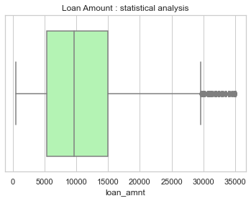
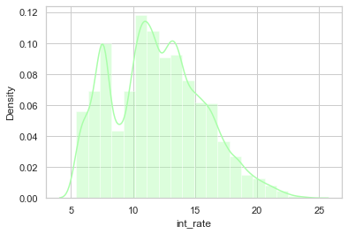
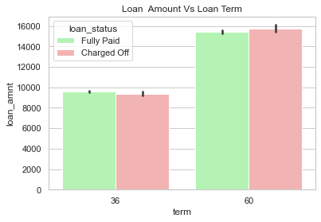
Univariate Analysis
Most loans are given between $5000 and $15000
Most Loans are given on the interest rate of 9% to 14%
Most loans are taken for 36 months

Slide 5
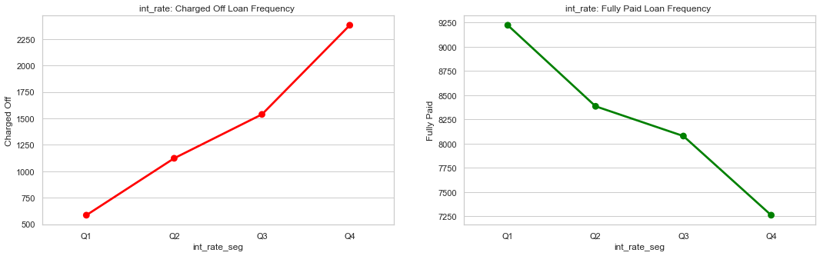
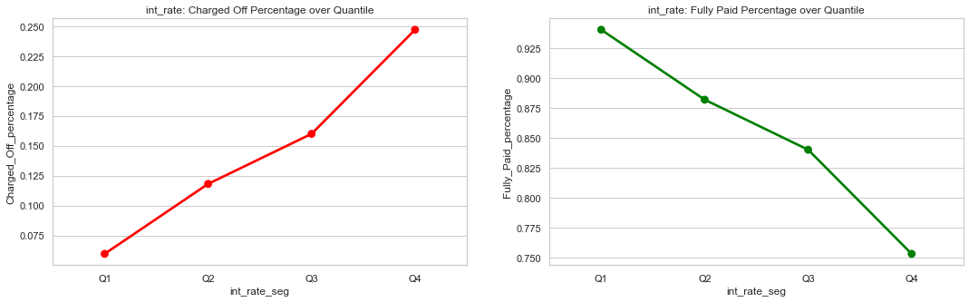
Univariate Analysis
Loan status is plotted against different categories of selected Features

Slide 6
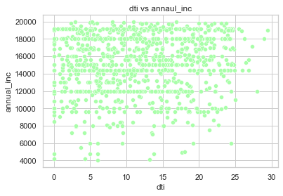
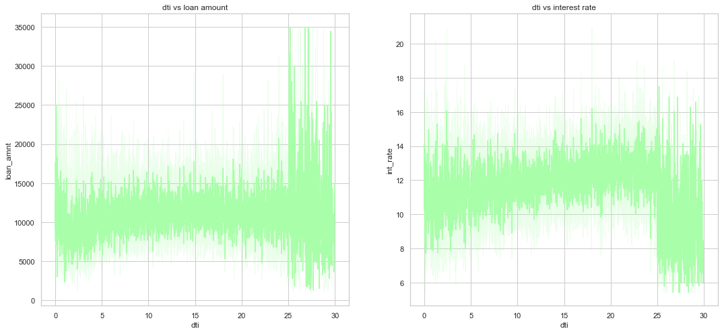
Bivariate Analysis
Scatter plot and Line plots are prepared against the selected features to identify correlation
DTI vs Annual Income has less significance where else loan amount is spread with DTI and Interest rate are low too

Slide 7
Recommendations
Based on the Exploratory Data Analysis performed, the following are the recommendations which are the driving factors in deciding the loan risk levels
Higher Debt to Income ratios corresponds to more defaulting
Small Business tends to be more risker Purpose compared to others
Loan Grades F & G are more riskier when combined with higher interest rate
Applicants with higher Annual Income are less riskier compared to lower income group
All the above features have to be looked together in determining the risky applicant and decision should not be taken based on one single feature mentioned

